Slide 1
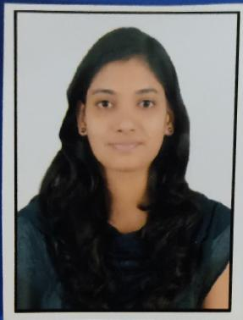


Pooja Palaskar
Analyst/Software Engineer
Bachelor of Engineering
Computer Engineering: 2016 – 2020
Skills C and C++
C#
ASP.NET
Saleforce (Basic)
Agile
Database:
SQL database
Web Technologies:
HTML
CSS
PHP
PowerShell
AddOns:
Postman
GitHub
Jira
Additional Details:
Leadership
Quick Learner
Team management
Pune
pooja.palaskar@capgemini.com
9766481706
A4
Willing to work as a key player in challenging & creative environment. Also, to secure a responsible career opportunity to fully utilize my training and skills, while making a significant contribution to the success of the company.
Proficient in creating Web Application in ASP.NET with MVC.
Ready to learn new technologies and implement them to further improve my knowledge.
Eager to work in a team of dedicated people and serve a key role in the enhancement and development of the project.
Student Management System:
Completed end to end case study of Student Management System along with JWT for authentication, Swagger.Use C# for UI Interface and SQL for Database.
Designed static webpage using HTML CSS JAVASCRIPT
Developed website with HTML and CSS along with JavaScript to make website more interactive and dynamic.
Working as C# developer on Macdonald project (RTI Team)
Development on Remote Imgaing Tool (RIT) using C# and Powershell.
Completed Agile development course at coursera .
Completed Azure Certification AZ-900, AZ-104, AZ-204, AZ-400, AZ-500, AZ-305.
,

